Slide 1
Logo
tzai-space.web.app
仁齋空間借用系統
Re-Design
陳冠宇
2024/2025
Product Designer & Developer

Slide 2
Agenda
1
Why Redesign?
2
Revision Target
3
UI/UX Design
4
Tech Stack
tzai-space
Notes:
* Before presenting, clear the tips below to add your presentation notes, speech and other important points to remember here* Agenda Page Tips Break down the main points or sections that will be covered in the presentation. Ensure the agenda is clear and logical to help guide your audience through the presentation. Help the audience understand what to expect

Slide 3


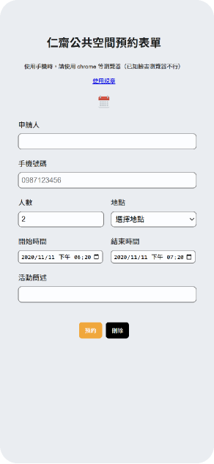
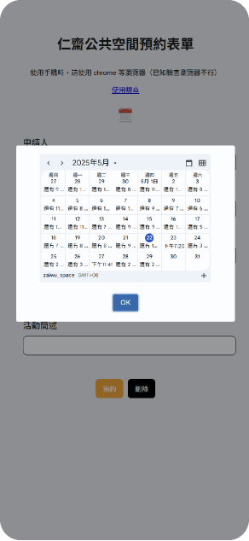
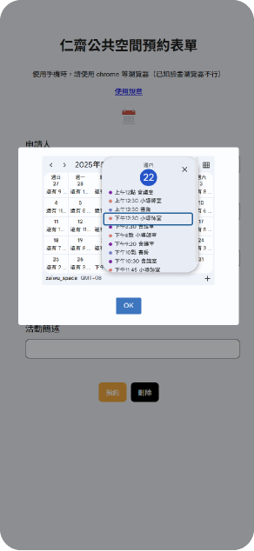
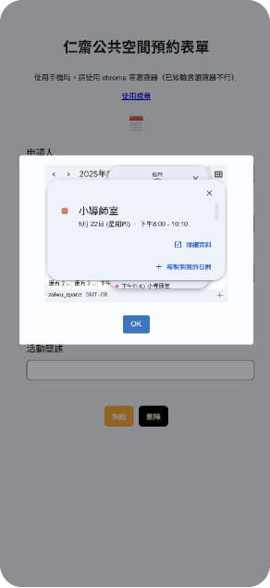
Old User Experience
tzai-space
Notes:
* Before presenting, clear the tips below to add your presentation notes, speech and other important points to remember here* Old User Experience Page Tips Provide screenshots or descriptions of the previous user interface and experience. Highlight key pain points or areas of dissatisfaction. Use this page to set the stage for why the redesign was necessary

Slide 4
Why Redesign?
01 視覺層面
設計老舊，缺乏品牌識別；介面過於緊湊、資訊層級不清晰足，
同時使用規章辨識度過低，導致沒有任何人閱讀，
02 交互層面
缺乏邏輯性與直覺性，交互過於密集容易誤操作，並且資訊層級太深，
需要至少四層深度才能取得詳情，並且刪除事件需額外聯絡管理員，
而這是五年前的系統，系統已長時間處於無管理員狀態。
03 管理層面
理論上每次借用有時間、次數以及數量的限制，以保障所有人的使用權益
但實務上舊系統卻沒有任何判斷機制，導致制度形同虛設
簡單來說就是，舊系統根本就沒有做任何設計...
tzai-space
Notes:
* Before presenting, clear the tips below to add your presentation notes, speech and other important points to remember here* Overview Page Tips You might want to start with an attention grabber. But majorly, this is where you give a brief sentence and overview on the subject.

Slide 5
Revision Target
結構太過深層
透過不同分頁以及元件設計
讓資訊以及功能層級扁平化
資訊過於密集
難以檢視和確認
設計好看的 UI 介面
使用流程不直觀
重新設計使用流程，並使用不同提示去管理使用進度
簡單來說就是，舊系統根本就沒有做任何設計...
tzai-space
Notes:
* Before presenting, clear the tips below to add your presentation notes, speech and other important points to remember here* Overview Page Tips You might want to start with an attention grabber. But majorly, this is where you give a brief sentence and overview on the subject.

Slide 6
用戶群體
User Analysis
70%
57%
使用行動裝置
蘋果用戶
Company Name
Notes:
* Before presenting, clear the tips below to add your presentation notes, speech and other important points to remember here* Pain Points Here’s where you give some background on your project. Some helpful questions to ask through: Use data and numbers to support the problem statement Visualize the statistics to make it easy to understand Why is this problem important?

Slide 7

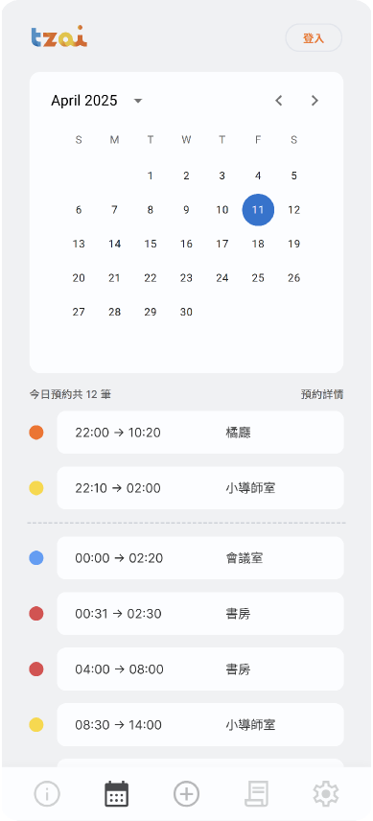
Full Stack Design
Calendar 日曆
自動加載當天事件，且新增了等待動畫，避免了等待加載時的空白頁面的負面感受。為仁齋的四個空間挑選出了四個不同的顏色，方便用戶判讀。
因為使用的高峰時段橫跨半夜十二點，因此明顯的標誌分隔今天與昨天是非常必要的，分隔線的增加提升了判讀的效率，以及有效降低了事件新增失敗的情形以及挫折感。
將使用深度降為兩層，分別是選擇天數以及檢視事件。只需要點擊事件卡，就會顯示事件詳情，並且系統會自動判讀是否為事件擁有者，從而出現刪除按鈕，極大幅度簡化刪除流程。
Notes:
* Before presenting, clear the tips below to add your presentation notes, speech and other important points to remember here* Solution Inspection Page Tips Provide a detailed look at the final solution. Include screenshots of the new design. Explain key design features, decisions and how they address the identified problems.

Slide 8
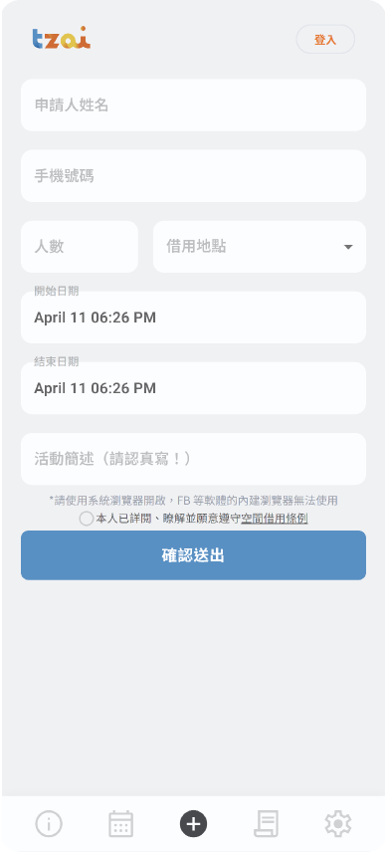
Full Stack Design
Apply Form 申請頁面
使用 Consent check box，確保使用者知情且同意空間使用條例，同時也設計了快速的頁面條轉，方面用戶閱讀。
表單元件使用 MUI 設計系統，確保整體視覺風格保持一致。並且使用其日曆套件，確保使用者有流暢的時間選擇體驗。全局共用 SnackBar 與 Diagram，共設計了十數種彈出提示，處理事件加載、等待情形、各種邊界情形的阻擋以及提醒。
加上淡色的小字做提示，避免用戶在臉書或賴等軟體的 in-app 瀏覽器中開啟。單色背景搭配品牌標準色強化主按鈕（確認送出），具備視覺引導力。
Notes:
* Before presenting, clear the tips below to add your presentation notes, speech and other important points to remember here* Solution Inspection Page Tips Provide a detailed look at the final solution. Include screenshots of the new design. Explain key design features, decisions and how they address the identified problems.

Slide 9
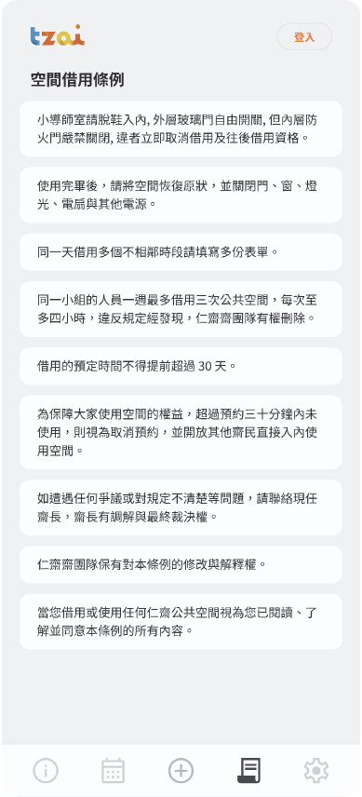
Full Stack Design
Rule 借用條例
以卡片式元件排版，便於閱讀與快速瀏覽。模組化的程式設計，方便日後維護快速新增和修改。
他很好看。
Notes:
* Before presenting, clear the tips below to add your presentation notes, speech and other important points to remember here* Solution Inspection Page Tips Provide a detailed look at the final solution. Include screenshots of the new design. Explain key design features, decisions and how they address the identified problems.

Slide 10
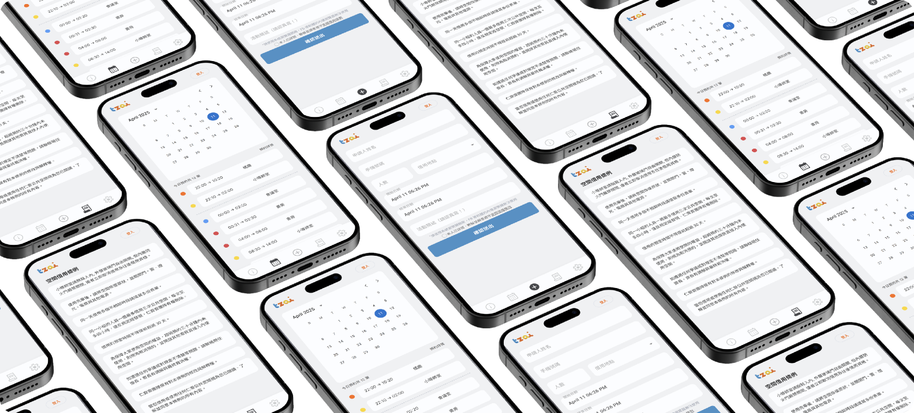
Product Screens
Notes:
* Before presenting, clear the tips below to add your presentation notes, speech and other important points to remember here* Product Screens Display Page Tips Showcase a series of screens from the redesigned product.

Slide 11
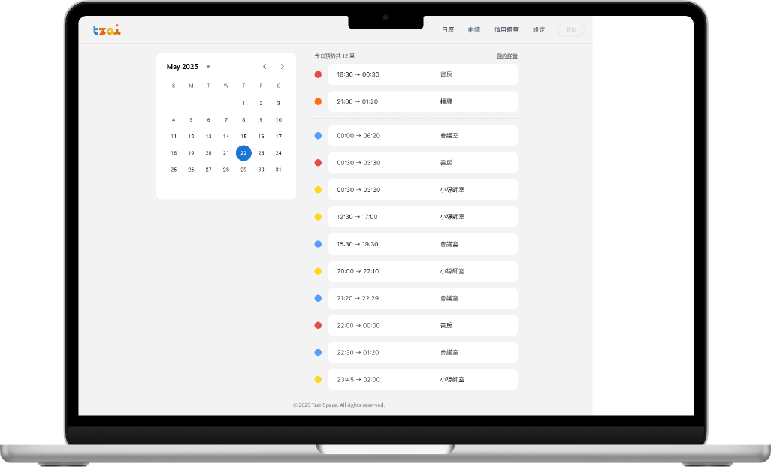
RWD: 電腦版介面
經過 Google Analytics 的持續追蹤與分析
雖然說有 70.3% 的用戶為行動裝置
但我還是為電腦版做了響應式的網頁設計

Slide 12
Teck Stack
01 前端
Vite + React + MUI + Tailwind CSS
02 伺服器
Firebase hosting + GCP
03 後端
Firebase Functions + Restful API + Google Calendar API + JWT Auth
04 分析
Google Analytics + Microsoft Clarity
簡單來說就是，舊系統根本就沒有做任何設計...
tzai-space
Notes:
* Before presenting, clear the tips below to add your presentation notes, speech and other important points to remember here* Overview Page Tips You might want to start with an attention grabber. But majorly, this is where you give a brief sentence and overview on the subject.

Slide 13
“
設計不止是乾淨的排版，所謂設計，是一種人與社會的對話，是落腳於生活的去看見需求，以及扎根於社會的解決問題。
- Guan yu Chen
tzai-space
Notes:
* Before presenting, clear the tips below to add your presentation notes, speech and other important points to remember here* Quote Page Tips Include a relevant quote that supports or underscores the presentation’s message. The quote could be from a user, a stakeholder, or an industry expert. Ensure the quote is concise and impactful.

Slide 14
感謝聆聽
仁齋空間借用系統 Re-Design
leosimba9487@email.com
Notes:
* Before presenting, clear the tips below to add your presentation notes, speech and other important points to remember here* Thank You Page Tips Conclude with a thank you message to the audience. Provide your contact information for any follow-up questions. Include a call-to-action, such as scheduling a meeting or visiting a website for more information.

